Slide 1
Reporting on progress
Year 7 2022-23
Dr Ellis

Slide 2
Reporting cycle (Y7)
Date | Information from school
28th November | First progress report
29th November | Parents’ evening
10th March | Second progress report
7th July | Final progress report

Slide 3
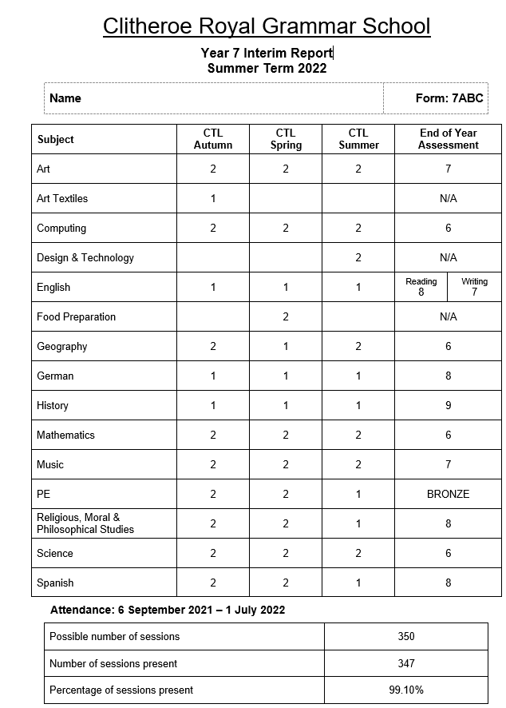

Slide 5
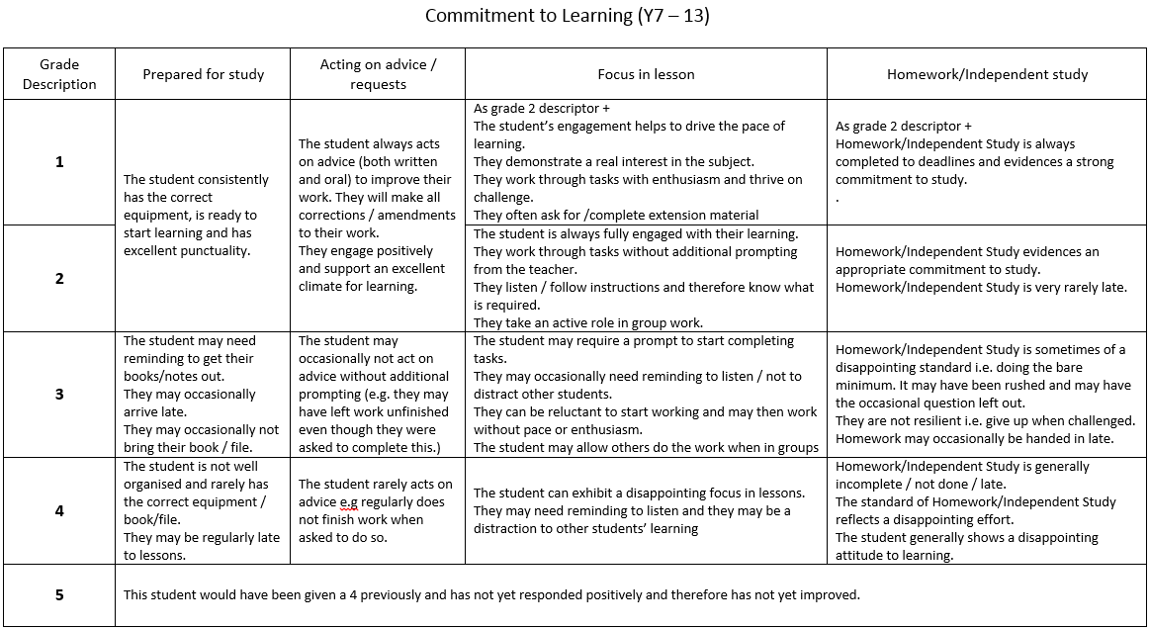
Commitment to Learning (CTL)

Slide 6
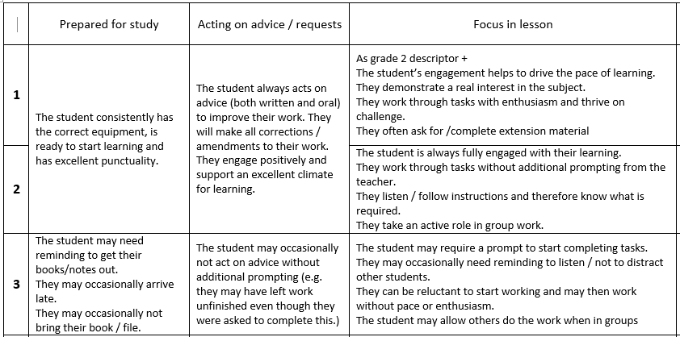
Your child should know why if have been given a 3 for a particular subject

Slide 7
How we use progress and CTL data
Departmental use for intervention
Year group summary data made for Head of Year and senior leaders
Some students move onto supportive report
Mentoring

Slide 8
Change in Y9, 10 and 11
Students are given a GCSE estimate based on their Key Stage 2 SATS, MIDYIS, progress made in Y7 and Y8
We add stretch to make this estimate challenging (so they would be within the top 25% nationally for value added)
E.g. A GCSE estimate of 7.2 would, on average, be increased to 7.7. This would mean a student studying 10 GCSEs would be on target if they gained 7 grade 8s and 3 grade 7s.

Slide 9
Summary
The first progress data is followed by a parents’ evening – this is the ideal time to query anything (29th November)
Exercise books are a good place to find current information on progress
Commitment to learning (CTL): 2 = a student doing exactly what they should

