Slide 1

Supporting your Child’s Learning
Mr J Alcock
Assistant Headteacher and DSL

Slide 2



My Roles in School
Academic monitoring and intervention
Lead pastoral team – Heads of Year and other staff involved in pastoral care and support
Support student (and staff!) emotional health and wellbeing
Notes:
Explain my role
Supporting students and managing student behaviour always creates a conflict that all Heads of Year also feel, we want to do our very best by every single one of our students and that remains at the heart of our work.

Slide 3
Academic Monitoring and Intervention
Commitment to Learning (CTL)
The most important thing in terms of academic progress is your child’s Commitment to Learning
This the main thing we look at (especially in the first couple of years)
If your child’s Commitment to Learning is good/excellent then their results will take care of themselves- this is not something to think about at this stage!
You will see CTL this on Interim reports

Slide 4
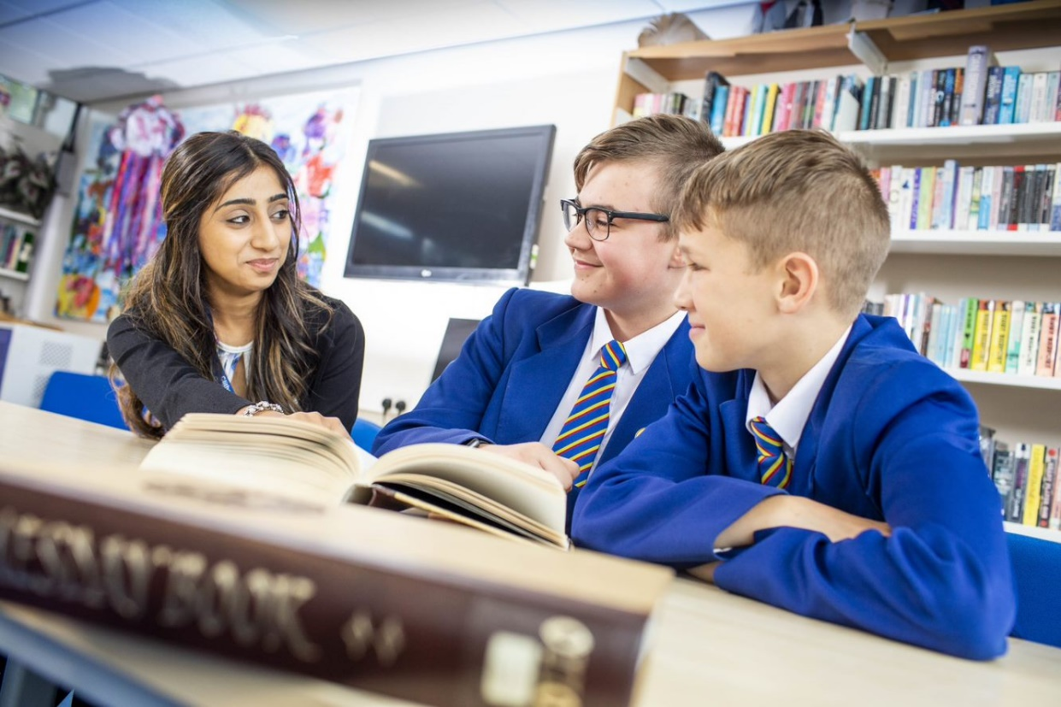
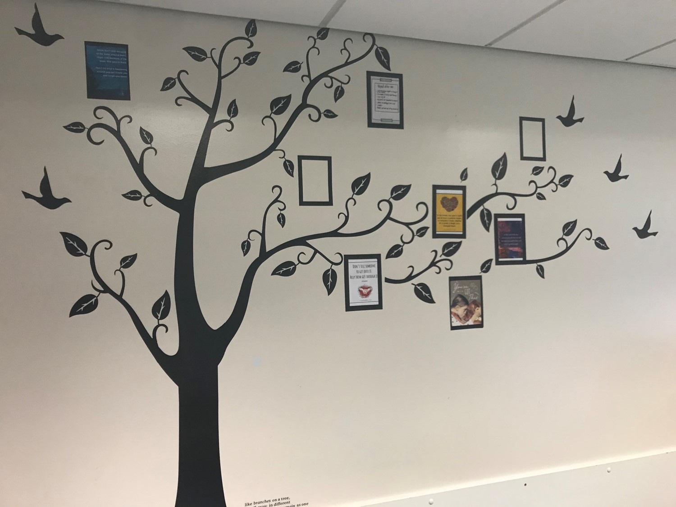
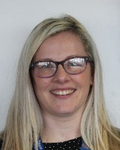
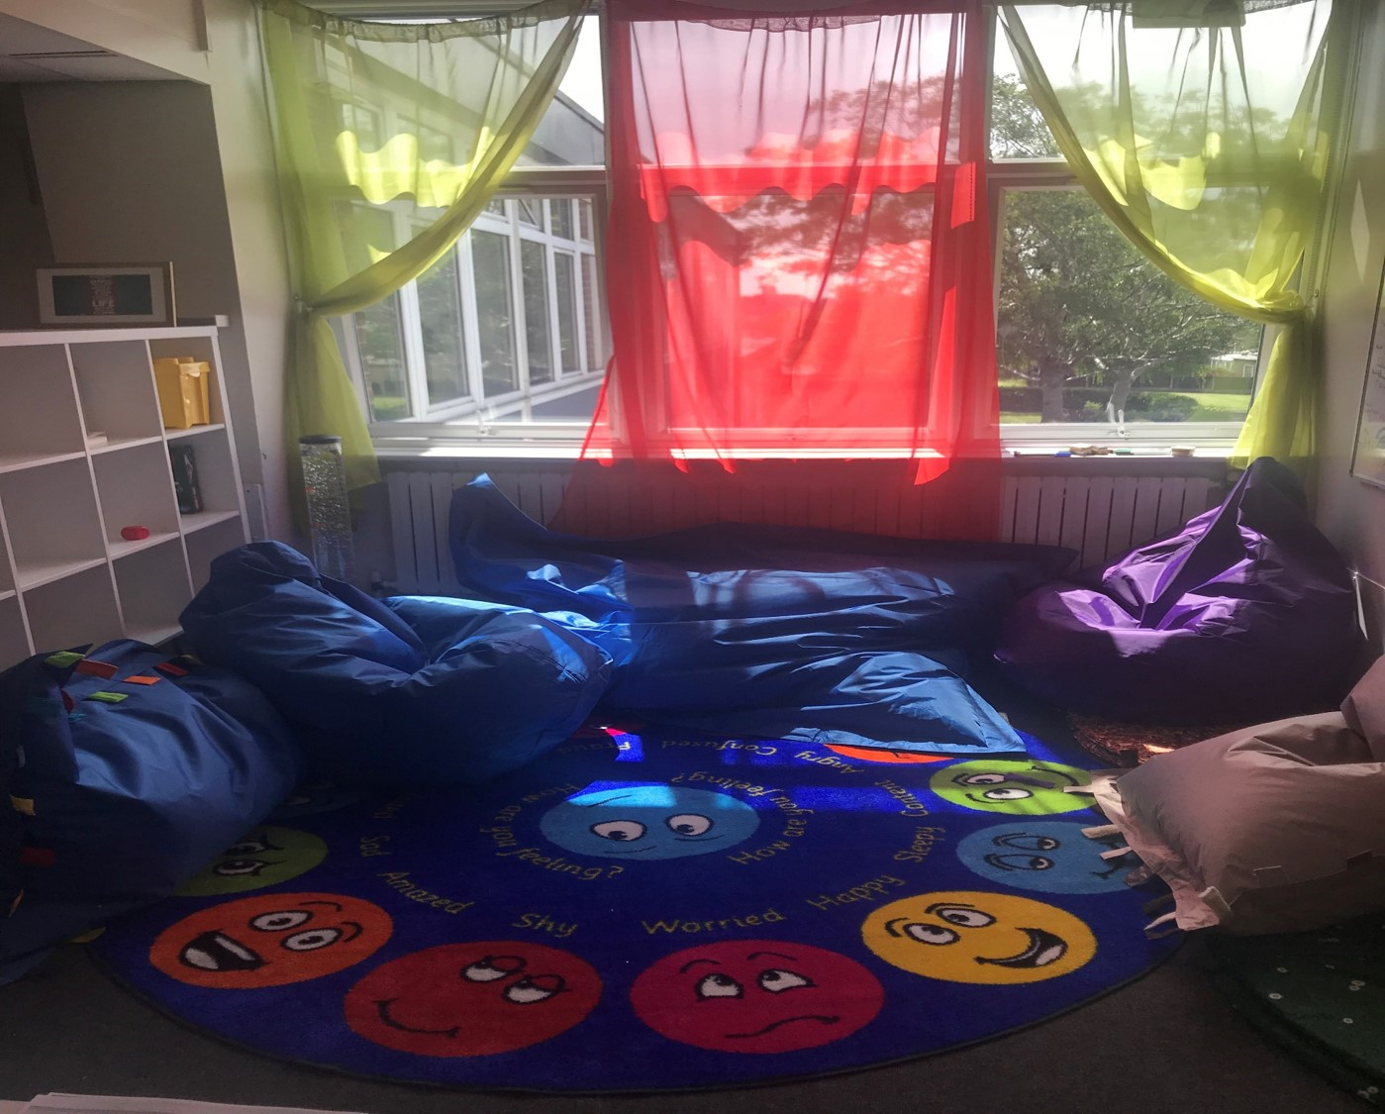
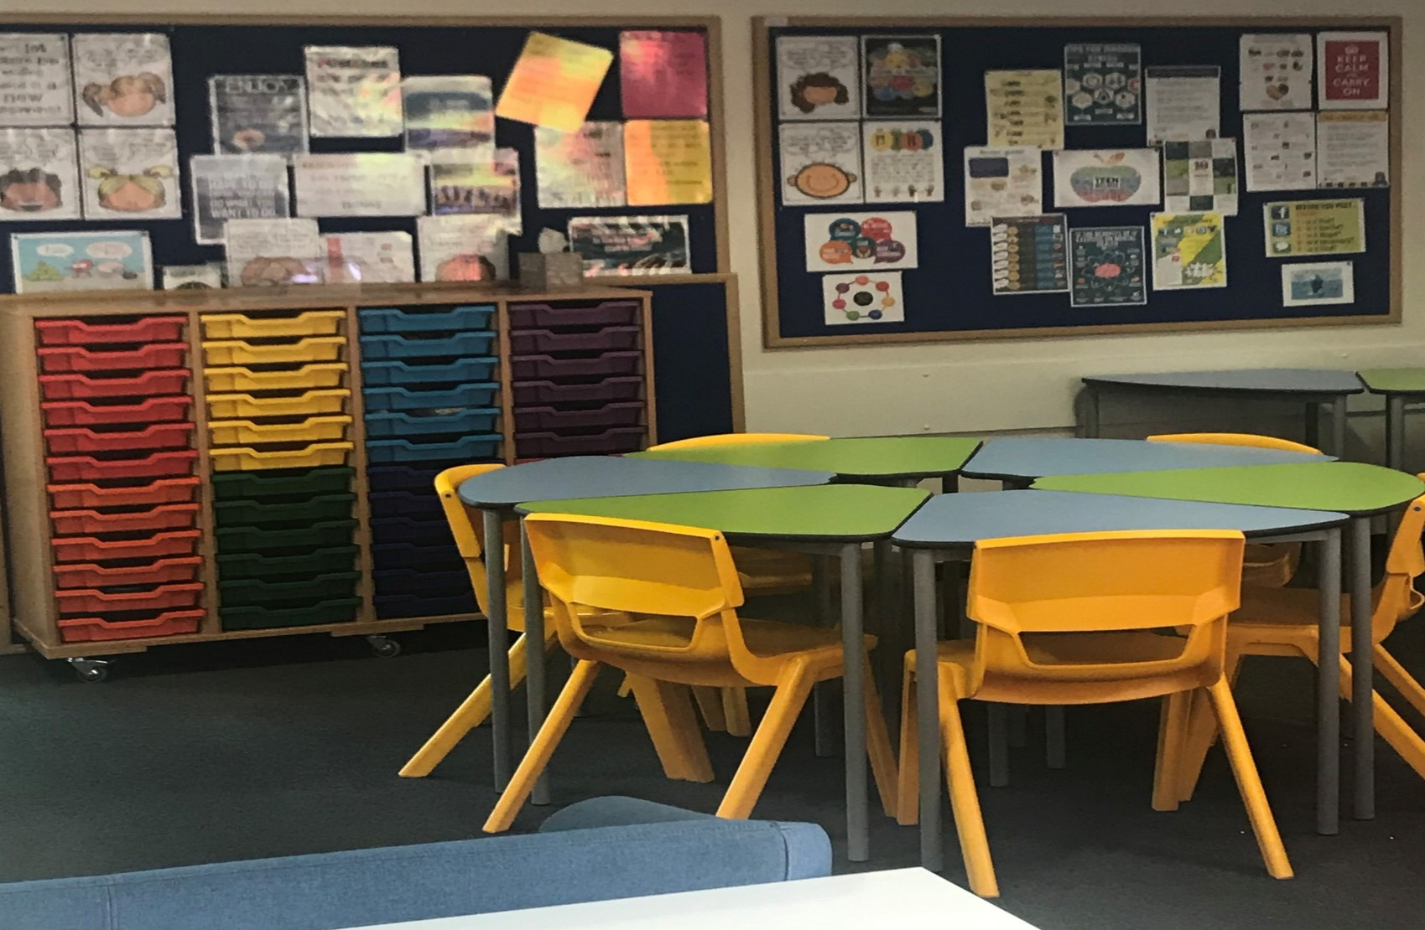

Pastoral Support
1-1 Support with Miss Quraishi, Head of Year 7 (email mainschool@crgs.org.uk)
Access to the NEST at breaks and lunchtime
Students can email Mrs Crow at any time studentsupport@crgs.org.uk
Mental Health Support Team (you may have seen them already in the canteen area)
#reframe
Nurture Breakfast

Slide 5




Supporting Students’ Emotional Health and Wellbeing
Personal Development Days
RECOMMENDED
Spend an hour a day doing moderate to vigorous exercise
No more than two hours a day in front of a screen
Get at least eight hours’ sleep each night
Avoid energy drinks and chose water

Slide 6

Transition from Primary School
No longer one key person with students for any length of time
The importance of the role of Form Tutors, Miss Quraishi and Mrs Crow
Communication with teaching staff is less frequent for parents/carers
Larger classes
Longer journey for most students
Thorough induction through the CRGS Passport to Success (including the Team Building day)
More opportunities!
A new start and a chance to thrive!

Slide 7
Working in Partnership …
School
Students
Home
Children of parent/carers who are actively involved with the school have:
Fewer behaviour concerns
Better academic outcomes
Teachers who intervene earlier
Teachers who communicate more with home
Working together is crucially important
Students need to see school and home working together with consistent key messages
Notes:
Analogy that is used in the book – all 3 legs are needed for the stool to be effective. Without enough effort on the part of the student, the stool will start to collapse. The same is true of the other aspects. Whilst your day to day involvement in your son/daughter’s education will change as they get older, particularly as they reach teenage years, you remain just as essential for a student to achieve their best in their education. Knowing that you are there is sometimes enough.

Slide 8

Home as a Place of Learning
These are values, attitudes and attributes students are encouraged to develop further in school.
Empathy
Collaboration
Concern for society
Confidence
Enquiring minds
Intellectual agility – creativity, open-mindedness, positive risk-taking
Effort
Perseverance
Resilience
Notes:
Values, attitudes and attributes that students are encouraged to develop in school but that we know are often more effectively developed at home.

Slide 9

Some Ways we see these Qualities at School
Be able to work in teams
Listen to the views of others
Present their own views clearly
Assume different roles in a group
Understand their contribution to society
Care for others less fortunate
Have belief in their own abilities
Challenge their own beliefs safely
Deal with new challenges and situations
Be kind to others
Respect everyone and take time to see things from their point of view

Slide 10


At Home and at School continue to Develop Intellectual Agility …
Curiosity
Be pro-active- ask questions, research things independently
Willing to work/think alone (without distractions)
Develop their own views and solutions
Open-mindedness
Work in unfamiliar contexts
Tolerate uncertainty and understand that mistakes are good, we all make them and they are how we learn!
Make informed decisions
Read for pleasure!

Slide 11

At Home continue to Encourage Effort and Practice …
Praise the effort not the outcome
Ensure students are always in school
Concentrate on the process of learning
Keep going and not give up
Work diligently and systematically
Overcome setbacks
Remain confident, focused, flexible and optimistic
Help others to move forward
Accept mistakes and learn from them
Don’t expect perfection
Don’t compare students to others

Slide 12
Practical Strategies to Support your Child
Continue to support with defined homework routines (consistency really helps!)
Parents/carers are responsible for monitoring screen time and ensuring appropriate behaviour
Encourage the view that there is value in working collaboratively with others
Help resolve any friendship difficulties positively
Support confidence and resilience
Try to be open-minded about ideas and encourage intellectual risk-taking
Expose your students to a range of (cultural) experiences eg Music, Arts, Sport
Promote the view that setbacks as a part of learning
Value and praise effort above achievement
Keep showing an interest in their day!
Keep communicating

Slide 13
Supporting the School as a Place of Learning
Teach time management and organisational skills (students to take ownership. Packing their own bag the night before, using their planner effectively etc)
Ensure students are in school and on time (excellent attendance is crucial)
Look at their homework/Commitment to Learning grades and discussing them together
Maintain good routines for homework, screen time, exercise, nutrition and sleep (see wellbeing slide)
Keep a focus on wellbeing first and their academic progress after this
Model behaviour - phones, reading for pleasure, taking time out to enjoy life, being kind!
Encourage extra-curricular clubs- Nest, Library, Computer room and being outside and active as much as possible

Slide 14
Excellent Attendance is vital…
Students should be in unless there is an exceptional reason not to be (see Newsletter)
Appointments outside of school time
Holidays outside of school time- 175 days a year students aren’t in school
Speak to us if there are issues and we will support you!
Percentage Attendance | Days lost to absence | 5 year context | GCSE Outcome
98% | 4 days lost
96% | 8 days lost
90% | 19 days lost (one day every fortnight) | Half a year of education missed | Underachievement by 1 GCSE grade in every subject
85% | 29 days lost
80% | 38 days lost (one day per week) | An entire year of education missed | Underachievement by 2 GCSE grade in every subject

Slide 15
To keep things simple we ask students to remember the BASICS at all times…
B- Be Kind
A- Activity
S- Say Something and Speak out
I- I am responsible
C- Connect and Communicate
S- Service

Slide 16
Supporting School
Give a clear message that you value and support school
Acknowledge that not everything will be ‘perfect’ (and rarely is!)
Support and promote our school rules
Realise that there are always alternative views and interpretations of events (we try to ensure we get a balanced complete overview)
Respect and support school’s decisions (they are made after careful consideration)
Encourage restorative approaches
Encourage your child to always be kind and treat others with respect
Expect excellent attendance and behaviour

Slide 17
Supporting School
Practical ideas:
Attend parents/carers’ evenings
Support school events whenever possible
Help out when you can eg cake sales, sports fixtures …
Consider becoming a Parent Governor
Follow us on Facebook!
Let us know if your child does things outside of school to help others or has achieved something (students are often to modest to tell us!)

Slide 18

If you have Concerns …
Telephone school to talk to Miss Quraishi Head of Year
or
Email mainschool@crgs.org.uk
We have 5 Designated Safeguarding Leads at Main School
We have a policy for dealing with concerns and complaints
and, finally…

