Slide 1
Family Literacy
Tuesday 4th October 2022
Using your reading and spelling skills to support your child

Slide 2
Reading
Passing on the Passion
Evidence suggests that there is a positive relationship between reading frequency, reading enjoyment and attainment.
(Clark 2011; Clark and Douglas 2011).

Slide 3
Weak readers struggle more in maths than in English literature
GCSE students with weak literacy levels struggle more with maths exams than they do with English literature, research has found.
A study of 370,000 secondary school students who sat GCSEs in 2018-19 found a significant correlation between students' reading ability and their eventual performance across all GCSEs.

Slide 4
What do we do at CRGS?
5 minutes reading every English lesson
- Reading Journey presentations
Register & Read every Monday in form
Year 7 Reading /Spelling Age tests
- Year 10 Literacy Leaders support reading fluency, comprehension and writing skills

Slide 5
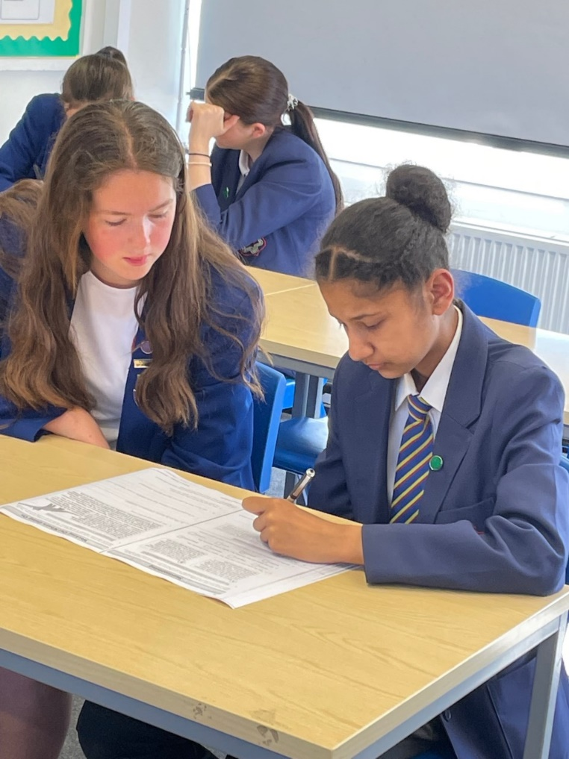
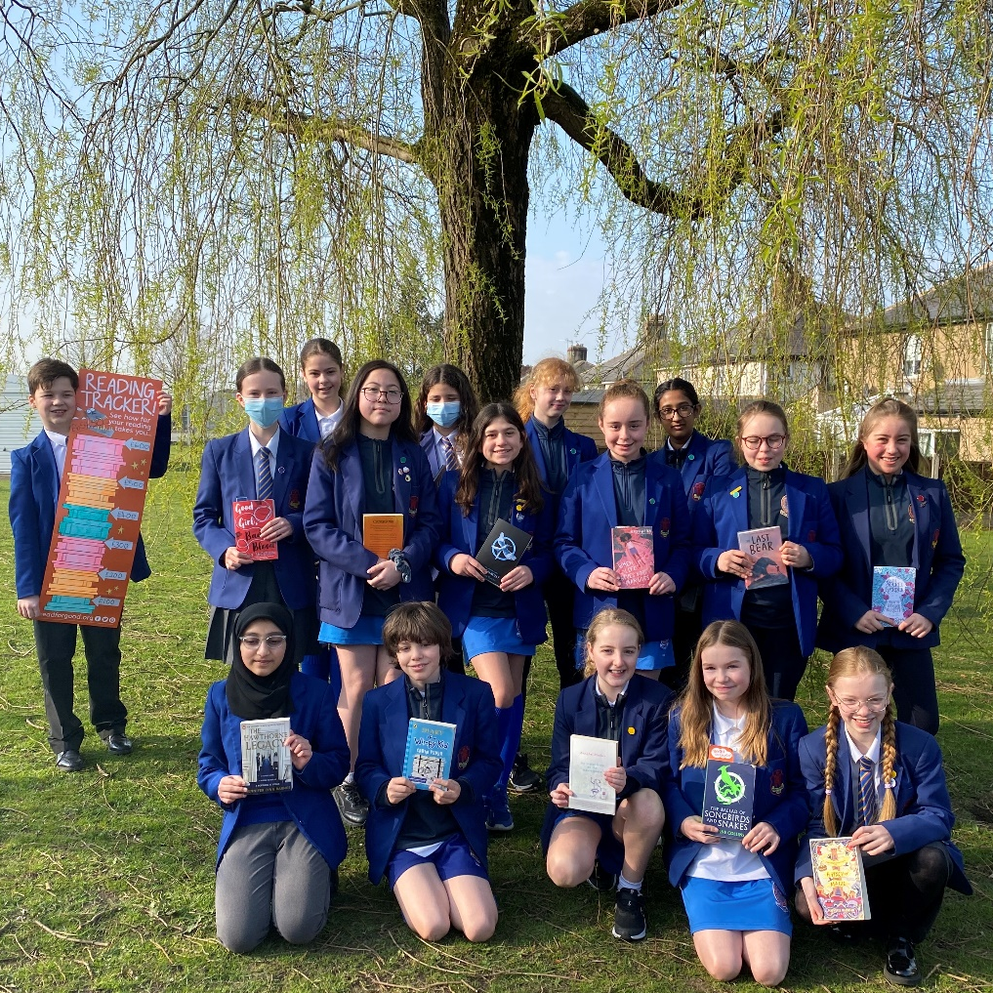
Literacy Leaders in-action
Read for Good Readathon

Slide 6
What do we do at CRGS?
Reading Ambassadors – Book Club every Wednesday
Read for Good Readathon
DEAR time each term
Caught Read-handed merits & prizes

Slide 7
Why is reading at home so important?
Parents who regularly read to their child have children who grow up to be readers.
Children have much more opportunity to read at home than they do at school.
“Three in ten children in the UK do not own a single book of their own, with alarming implications for their future prospects… boys are less likely to own books than girls.” (The National Literacy Trust)

Slide 8
Why is reading at home so important?
A new report from the Oxford University Press has highlighted the importance of parents reading with their children.
As little as ten minutes a day can make a significant difference to achievement levels, it claims.
The report shows that children who read outside of class are 13 times more likely to read above the expected level for their age.

Slide 9
Common Parental Worries
“My child used to read a lot, but now s/he has stopped.”
“We’re really keen readers, but our child isn’t.”
“We don’t know what our child should be reading.”

Slide 10
“My child used to read a lot, but now s/he has stopped.”
Possible solution:
Find a new genre – this could even mean swapping to non-fiction, particularly with boys.
Reading magazines, newspapers and shorter texts may be more appealing to your child than fiction.
ReadTheory – non-fiction texts and quizzes.

Slide 11
“We’re really keen readers, but our child isn’t.”
Possible solution:
Don’t panic!
Once again, explore different genres together. Try reading the same book and discussing it over popcorn.
The ability to summarise a text clearly demonstrates understanding – fluency is not comprehension.

Slide 12
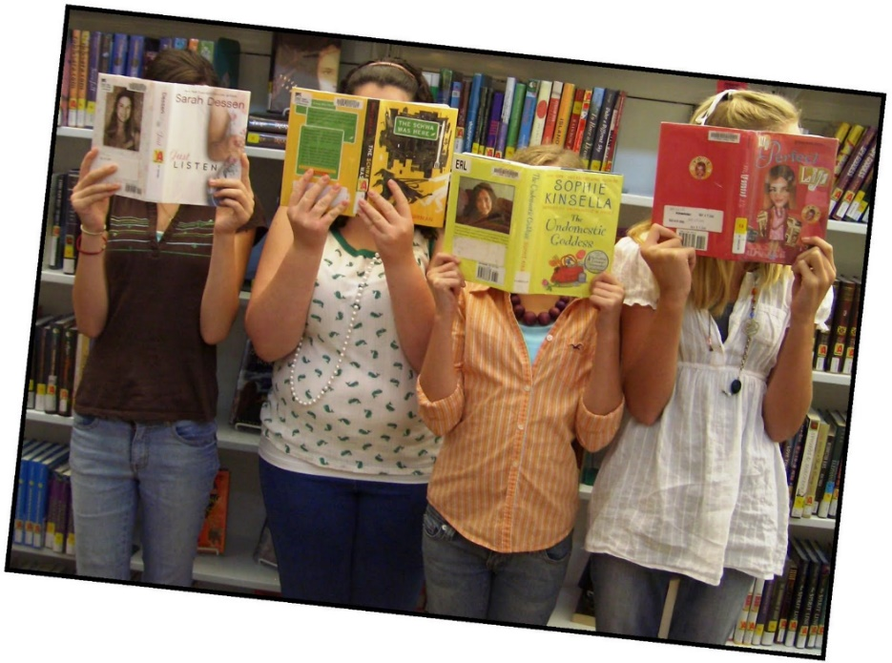
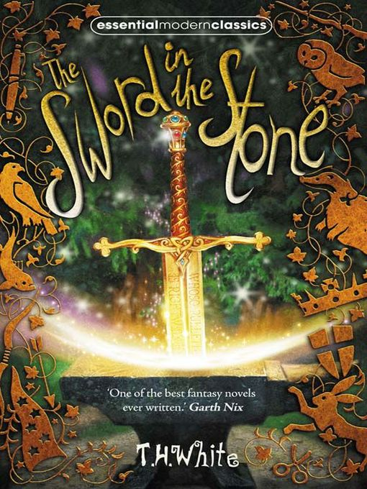
“We don’t know what our child should be reading.”
Possible solution:
Reading lists in English exercise books…
Reading Journey in the back of English exercise books – discussed in class.
And a little bit of sharing…

Slide 13
Local libraries: www.lancashire.gov.uk

Slide 15
SPELLING

Slide 16
Why are we so worried about spelling?
“Children are marked on spelling in school from early on.”
“Parents of children with poor spelling worry about their child’s ability to produce the kind of written work needed to succeed in school.”
“Adults who can’t spell may feel ashamed, and fear they appear uneducated or unintelligent to others.”
Linda Balsiger, The Secrets of Spelling

Slide 17
What we do at CRGS
Key vocabulary / Word Walls
Word of the Week – student bulletin
Dictionaries and thesauruses in every classroom
Proof-reading skills
Students are encouraged to correct their work independently across the curriculum

Slide 18
Academic Vocabulary Books
KS3 ‘Word Spies’ in English lessons.
Academic Vocabulary books to record Tier 2 and 3 vocabulary across the curriculum.
Tier 2 vocabulary is more academic and nuanced in nature and includes high frequency words such as ‘analyse’ ‘’quantify’ and ‘examine’, whereas Tier 3 vocabulary consists of low frequency, subject-specific terminology such as ‘algorithm’, ‘cardiovascular’ and ‘Renaissance’.

Slide 19
What you can do at home…
Check the spellings with which your child is struggling.
Focus on NO MORE than 5 spellings per week.
Little and often – five to ten minutes per day only.
Encourage your child to use their purple pens to edit and improve their work.

Slide 20
Thank you!

